Slide 1
What is Data Science?

Slide 2
What is the science in Data Science?
The Scientific method:
Evidence-based advancement of knowledge.
Reproducibility is key.
Data Science:
Collecting high quality data is becoming cheaper and cheaper.
Focus is shifting from building better sensors to building better software.
Reproducibility is key.

Slide 3
Model Refinement
Start with a question
Collect Data, or receive data from others.
Create a model for what is “normal” or “predictable”
Identify trends that are not predicted and are statistically significant.
Update model
Repeat
Benefits:
Predict
Detect anomalies
Identify optimal parameter settings.

Slide 4
Interpretability
Some modeling can be done without interpretation:
Object detection using Neural Networks.
In many cases interpretation is important.
Science
Medical research.
Explanation for classification is important for building trust:
Bank Loan Approval / Denial
Medical decisions: ventilator – no ventilator

Slide 5
Data Science is an Inter-disciplinary
Most Data Science projects have two types of researchers:
Domain experts: people with expertise in the particular domain:
Collect the data.
Label / annotate the data.
Formulate the questions. Provide context, intuitions, ideas.
Judge the relevance of the quantitative findings.
Methods experts: Statisticians/Computer Scientists/Mathematicians:
Translate ideas and intuitions into quantifiable questions.
Use data to answer questions.
Communication skills are key!

Slide 6
Some real life examples of data science

Slide 7
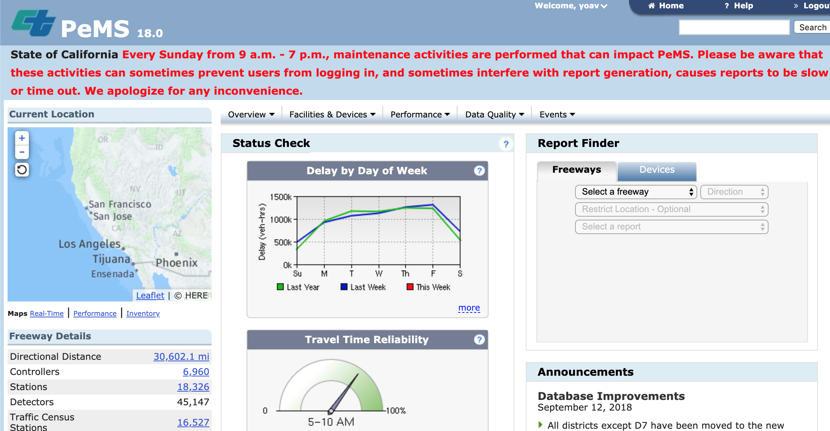
Caltrans: PeMS (Performance measurement system)

Slide 8
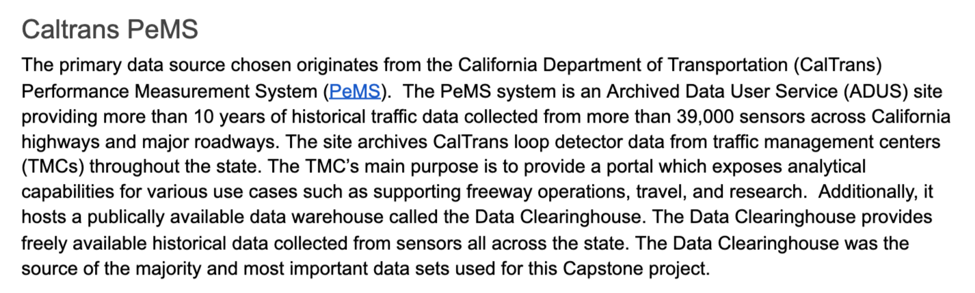
MAS-DSE Capstone Project, 2016 Kevin Dyer, John Gill III, Conway Wong

Slide 9
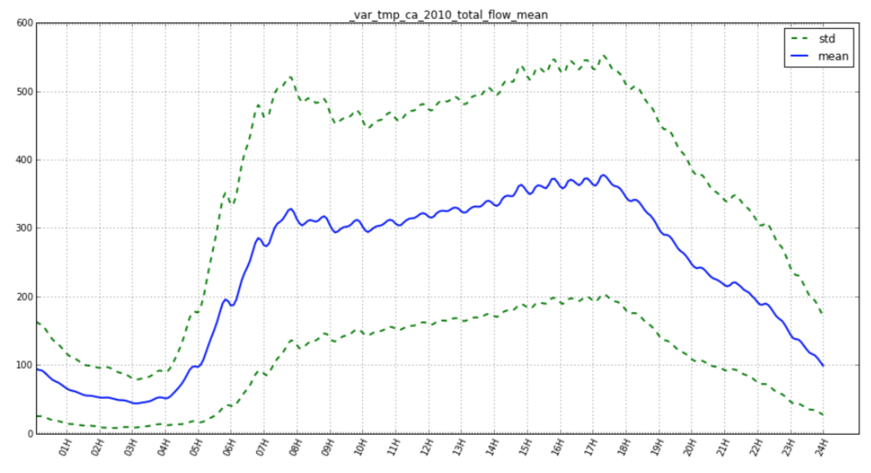
Mean and STD of total flow (cars per minute)

Slide 10
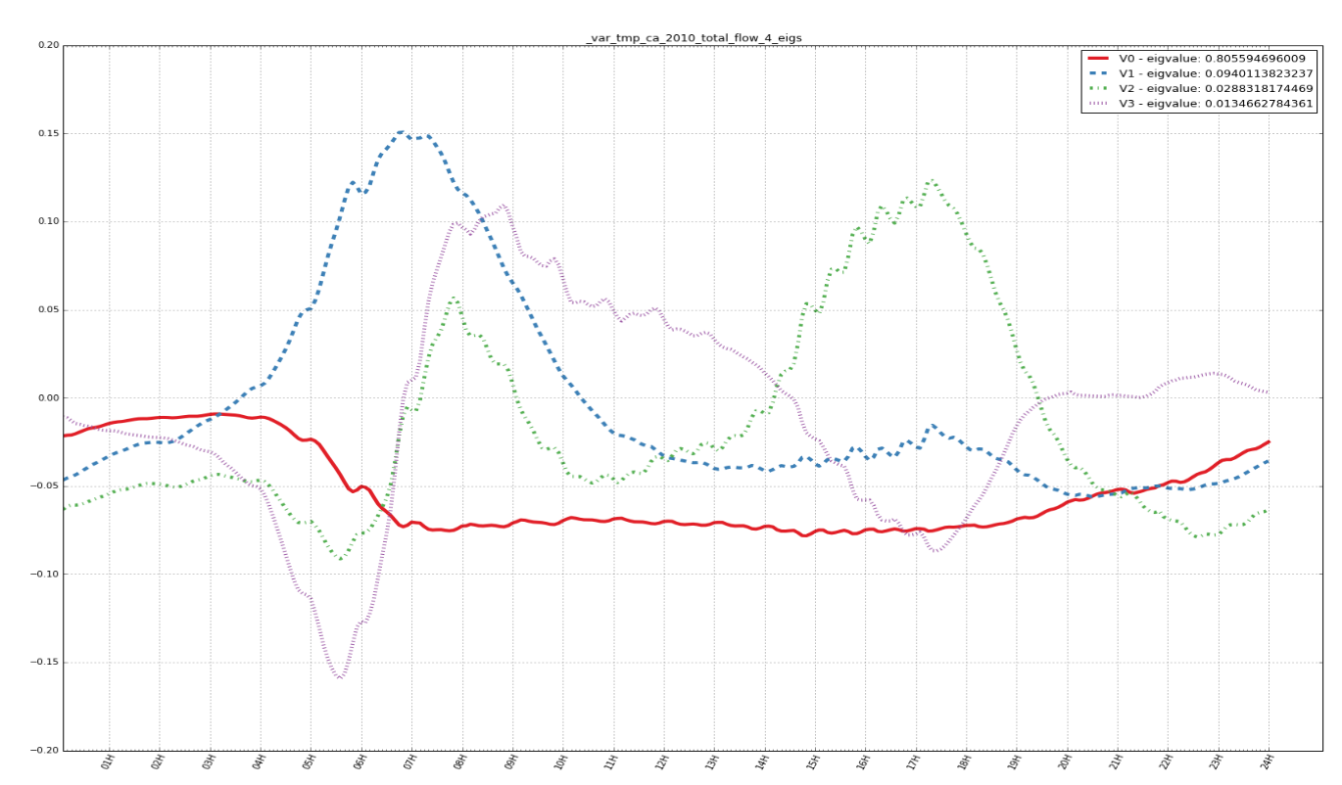
Top Eigen-vectors

Slide 11
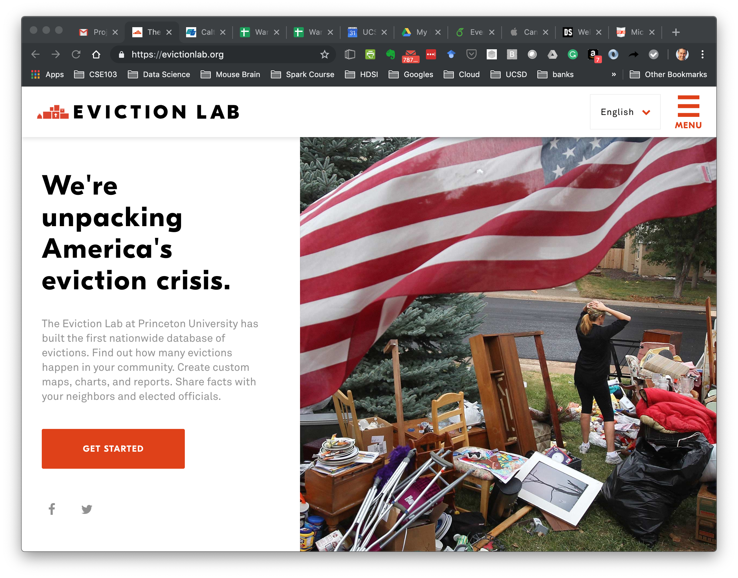

Slide 12
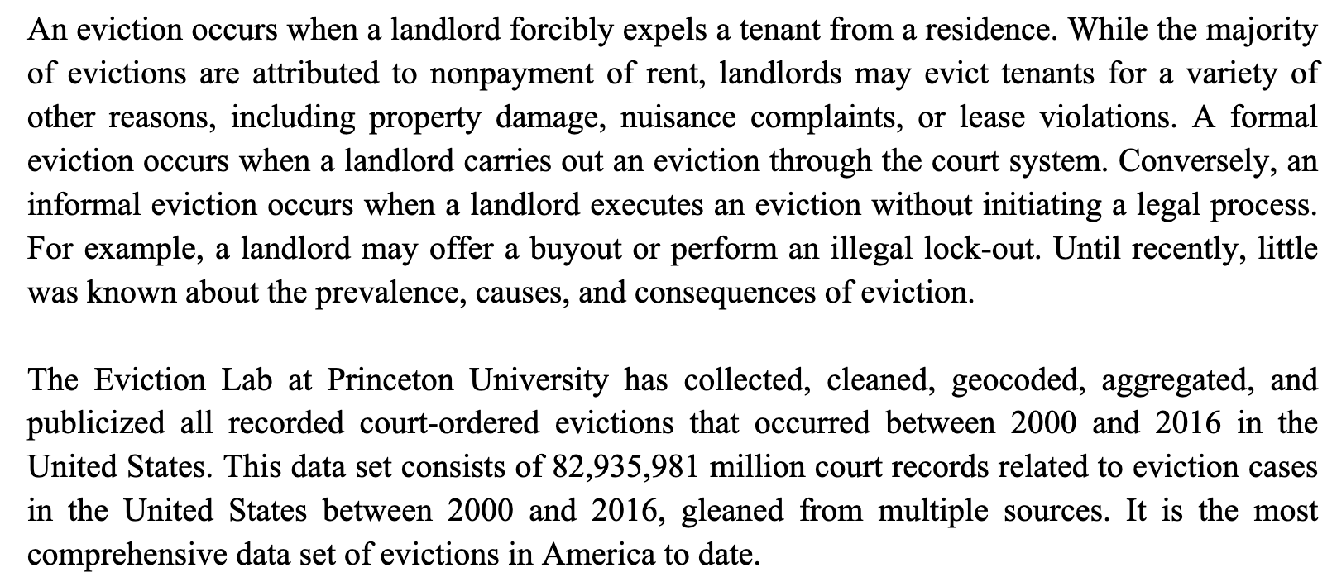
Eviction Labs

Slide 13
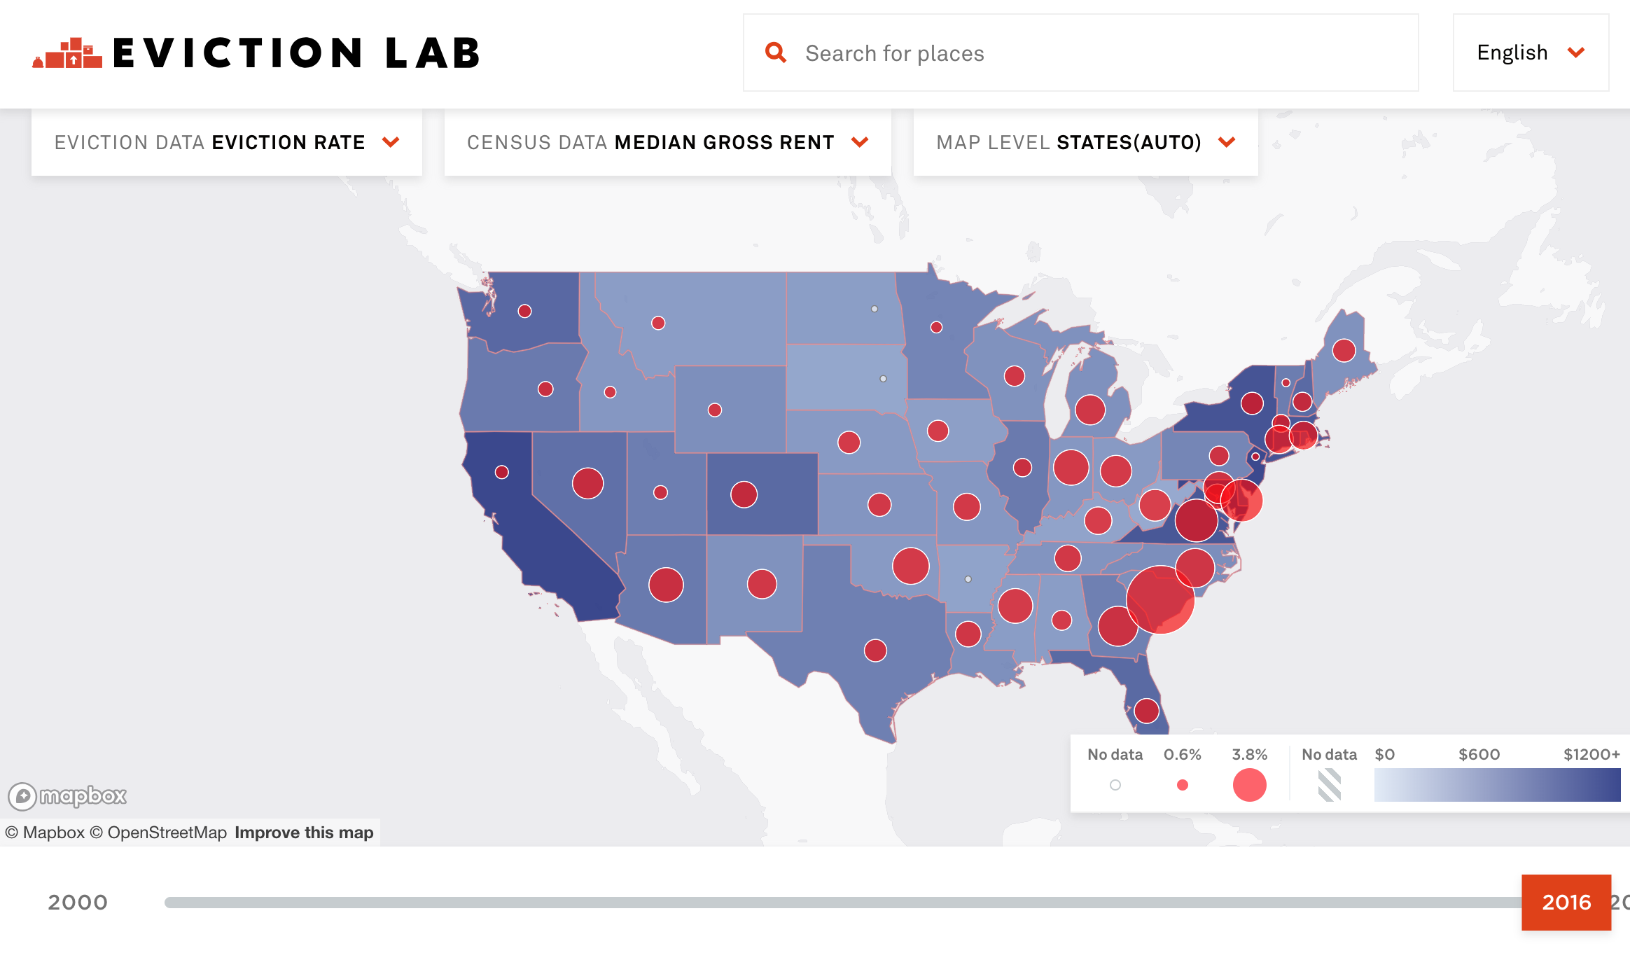
Visualization

Slide 14
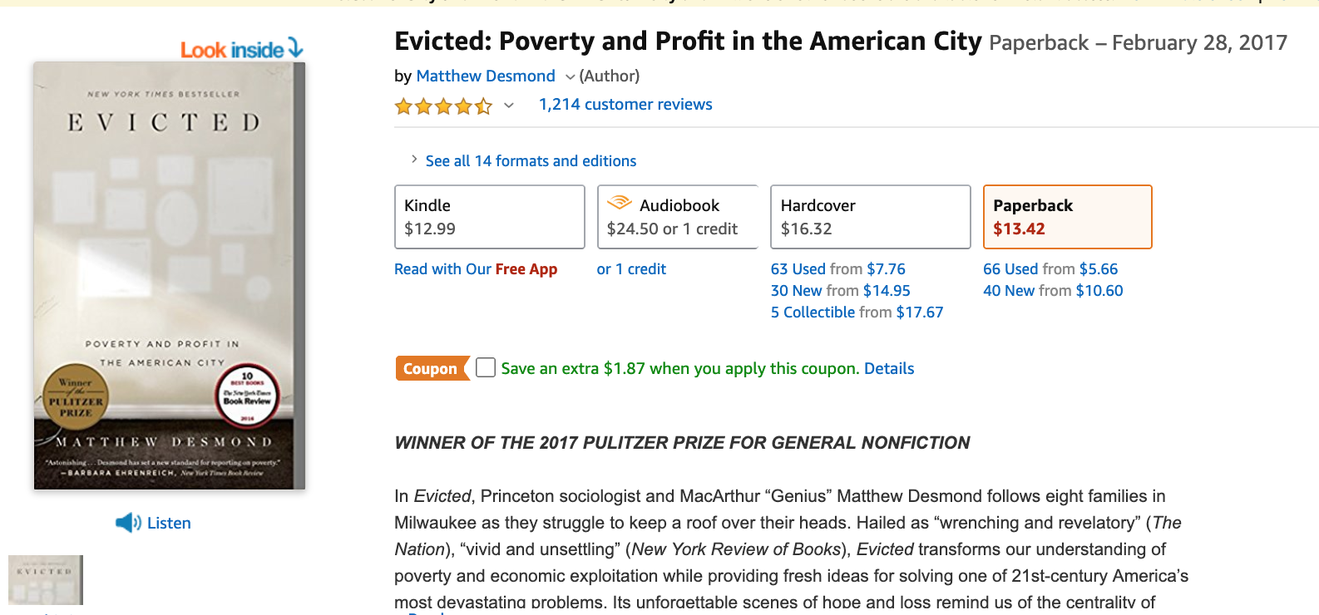
Analysis

Slide 15
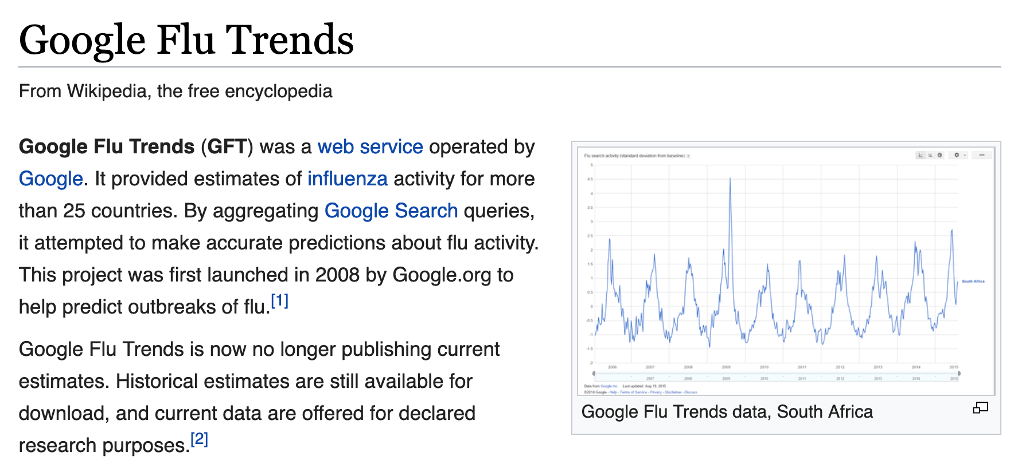

Slide 16
Communication Tools
Platforms:
Conversational: eMail, Slack, Zoom
Persistent: Github, gDrive

Slide 17
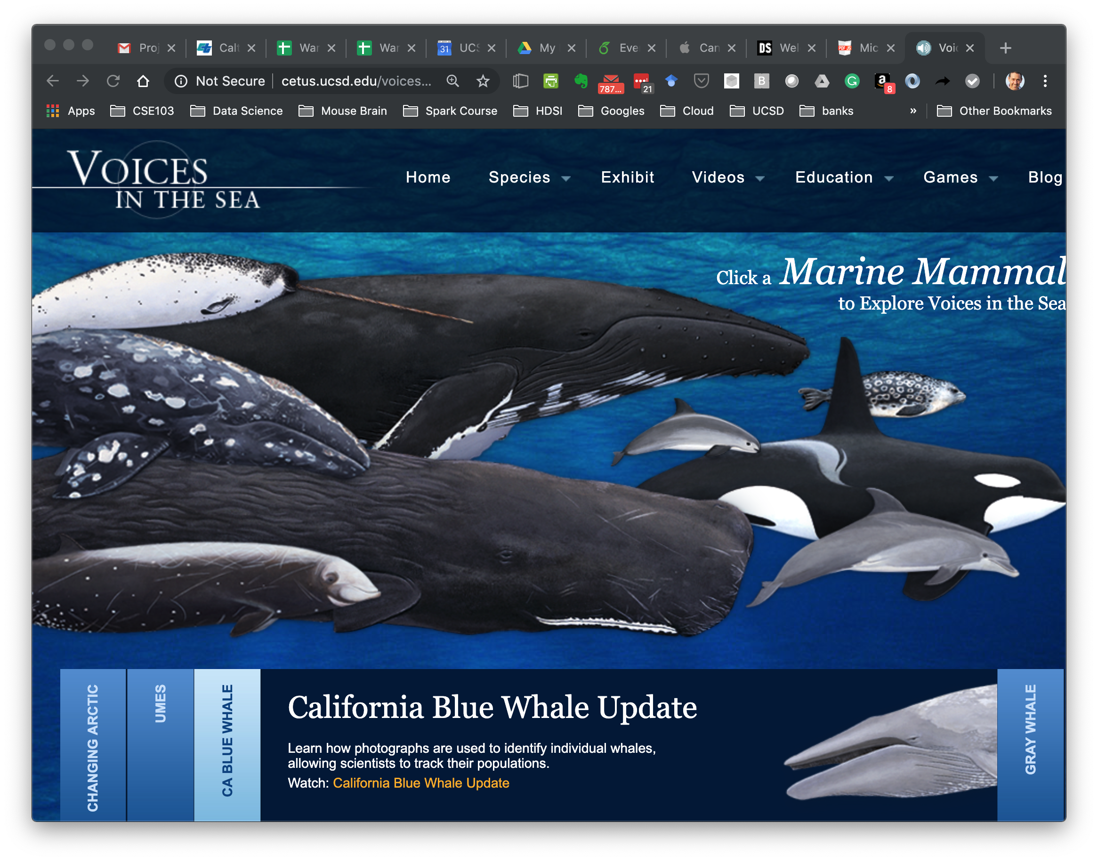

Slide 18
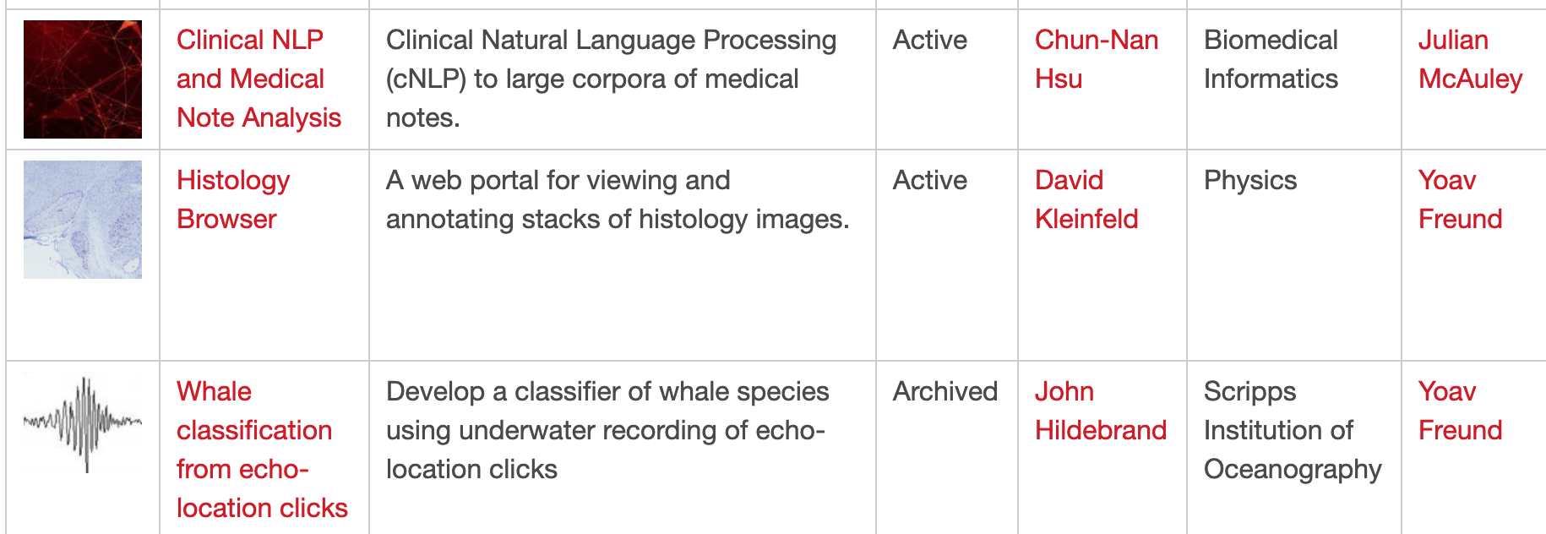
Whale Echo-Location clicks
SDSC Matchpoint (https://datascience.sdsc.edu/matchpoint) is a clearing house for data-science projects.

Slide 19
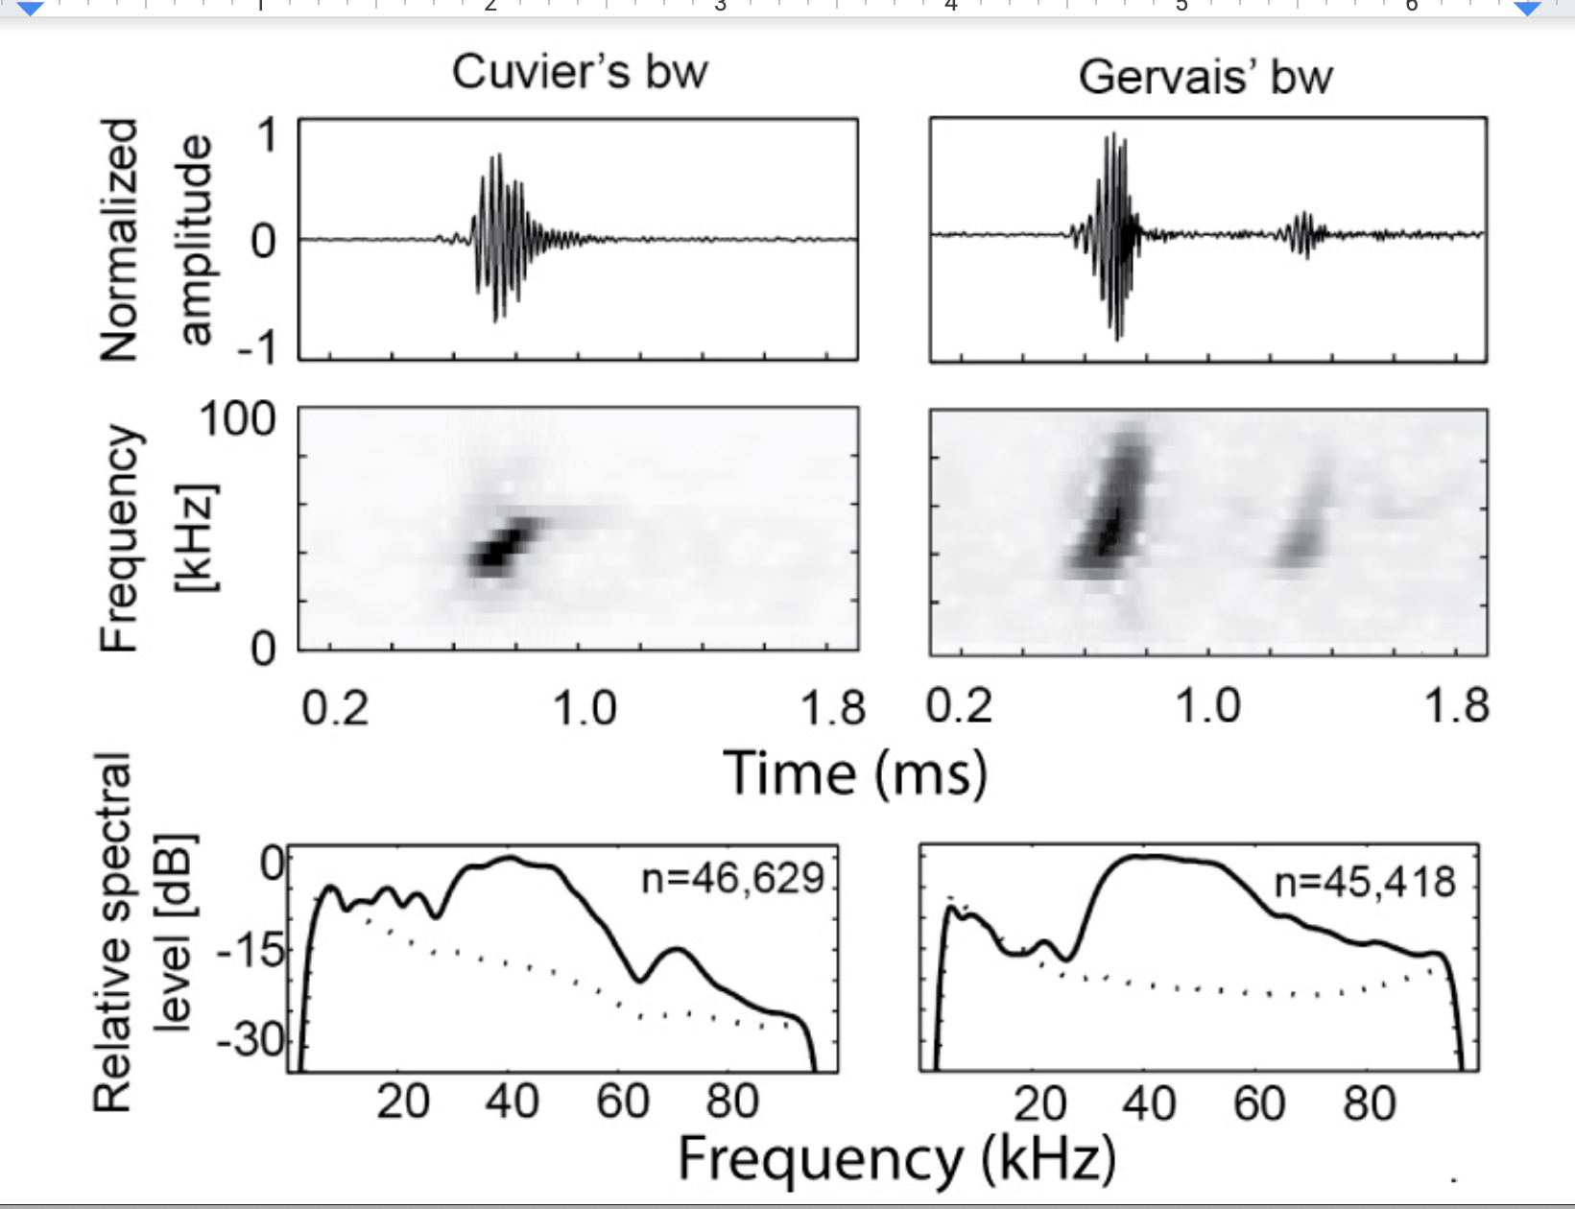

Slide 20
Data from the ocean
Harps and Arps
Continuous recording at 200 Khz
Recorder is retrieved after a year.
Generates 2TB of data
Processing takes about 2 weeks.
Why: throughput of one computer is ~ 100MB/Sec
Using 2 cores helps. More than that : same or worse

